Slide 1
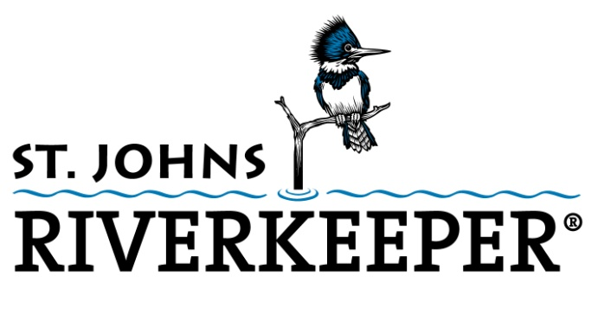
MISSION: SAVE THE ST. JOHNS
Notes:
This presentation is about the health of two important bodies of water that are interrelated – the St. Johns River and the one below our feet, the Floridan Aquifer – and what we can do to help protect these invaluable resources.

Slide 2
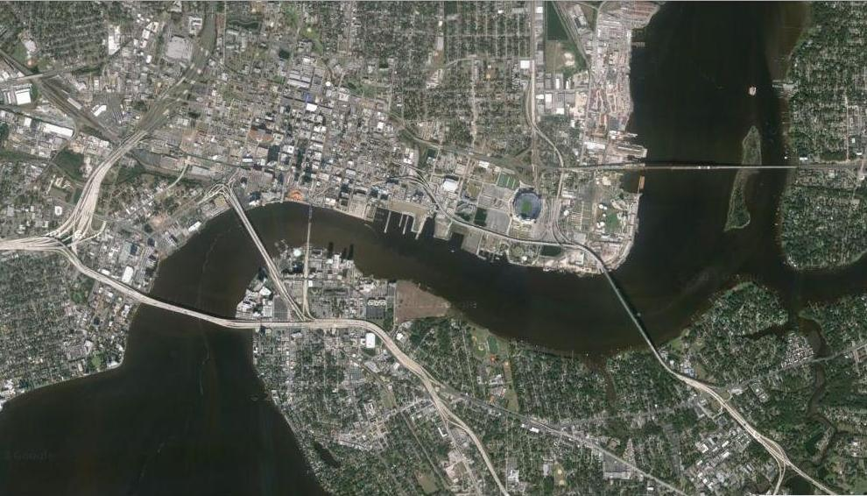

Slide 3
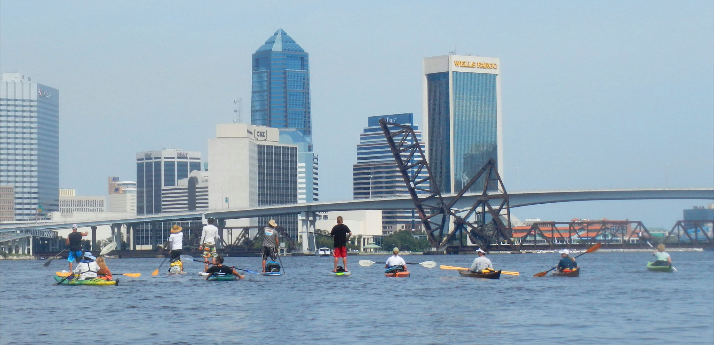

Slide 4

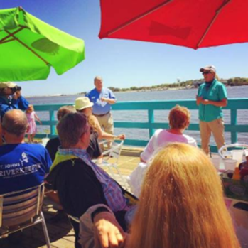
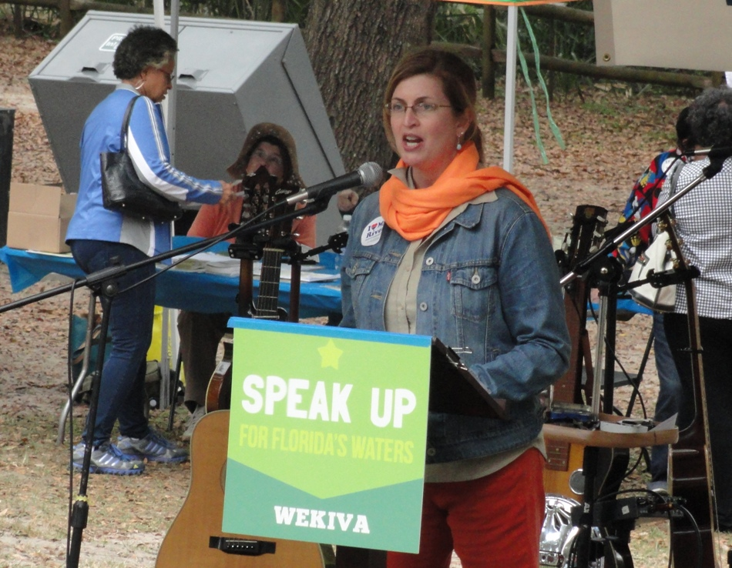

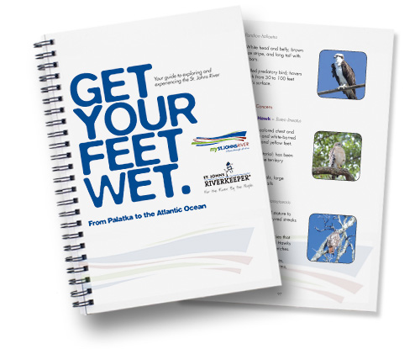
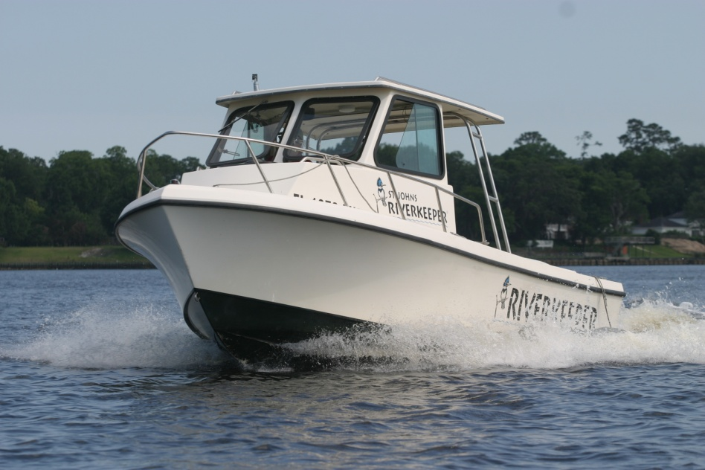
Investigate Pollution Problems
Advocate for Policy Changes
Seek Solutions
Educate the Public
Raise Awareness
Engage and Involve Citizens
Hold Agencies Accountable
Notes:
St. Johns Riverkeeper is a non-profit 501(c)(3) organization that serves as a full-time advocate for the St. Johns River. We are an independent voice for the river.
St. Johns Riverkeeper is a membership-based organization that is privately funded. St. Johns Riverkeeper does not receive any government funding. We rely on the generous support of businesses and concerned citizens who recognize the importance of the St. Johns and the value of having a full-time advocate representing the interests of the river and the public to whom it belongs.
Photos: The St. Johns Riverkeeper on our boat, The Kingfisher; movie poster from our documentary, “The Green Monster”; Get Your Feet Wet guidebook to the St. Johns River from Palatka to the Atlantic; a volunteer leading a water quality testing activity with kids on one of our educational boat trips.

Slide 5
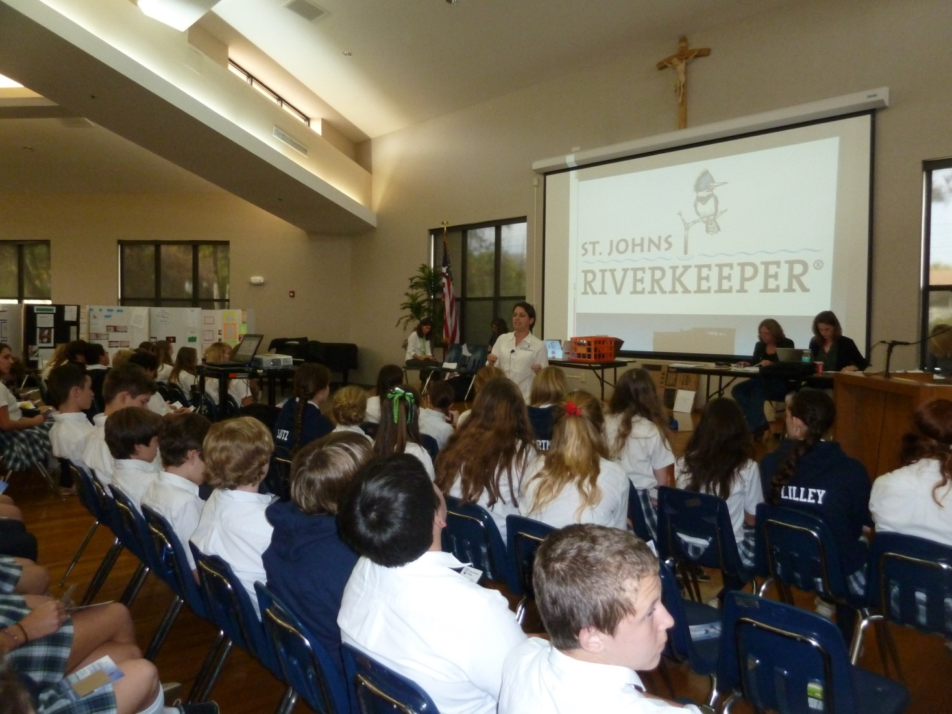
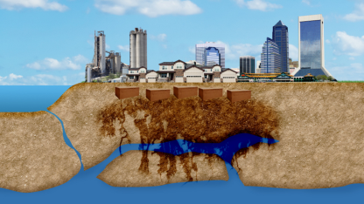
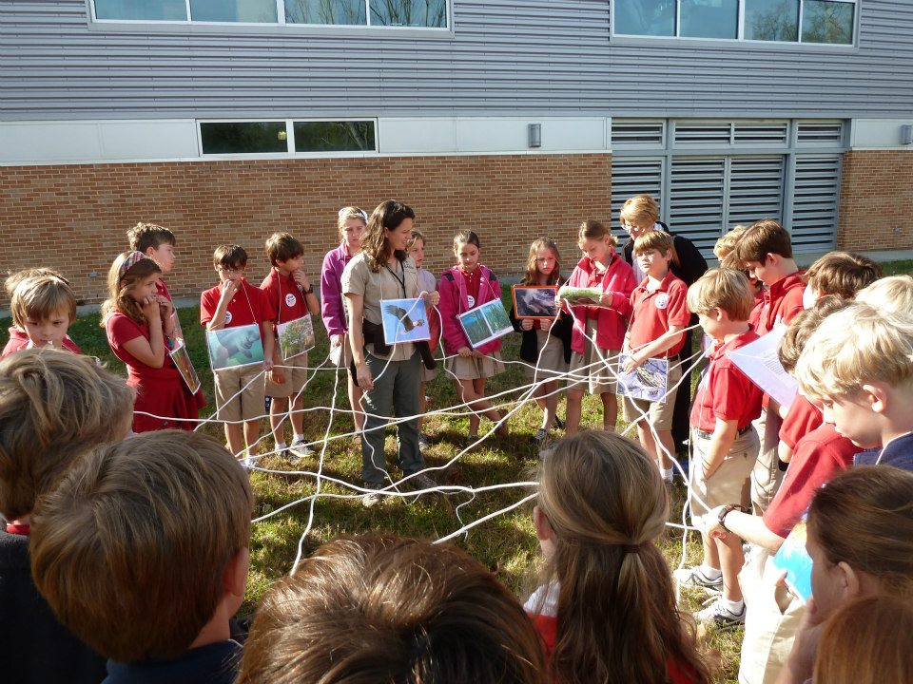
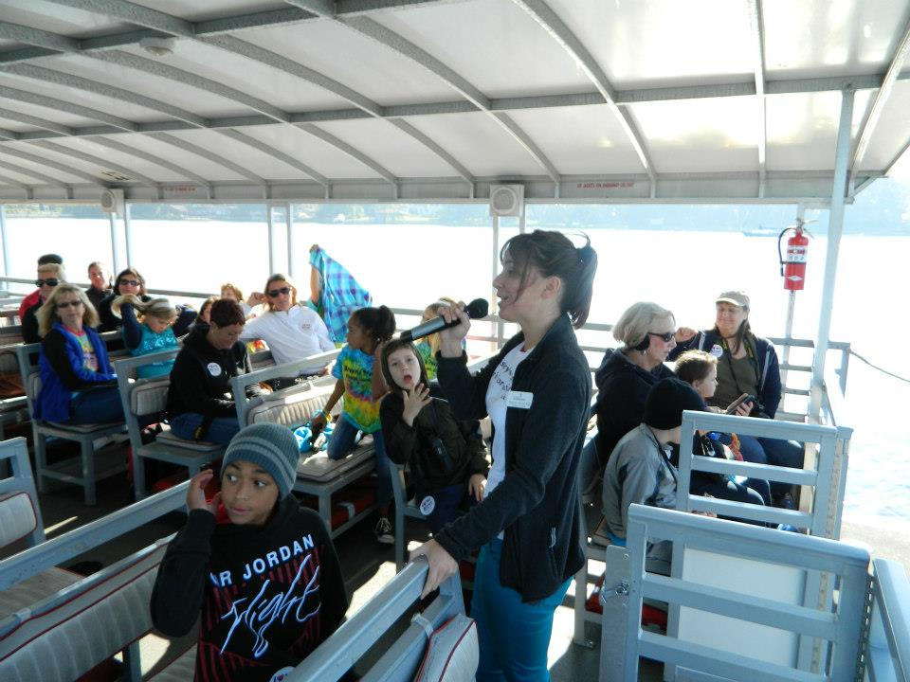
EDUCATE

Slide 6
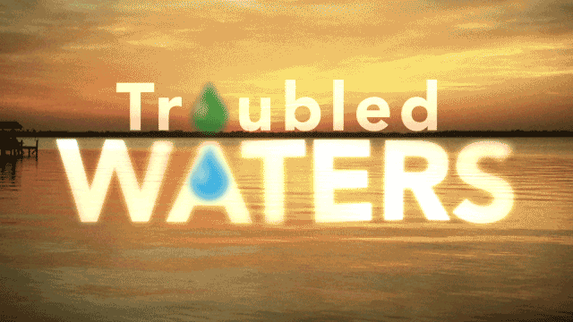
Call to Action for all of Florida’s Rivers, Lakes, Springs, and Aquifers

Slide 7
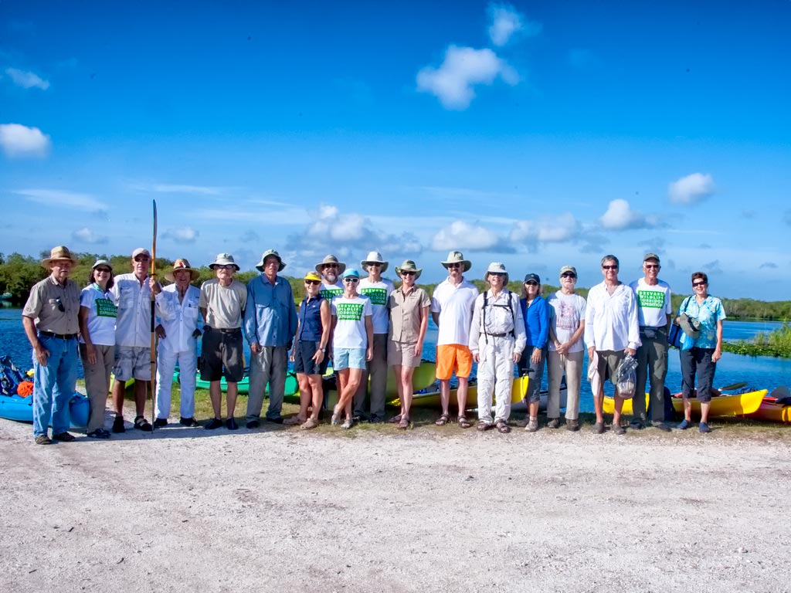
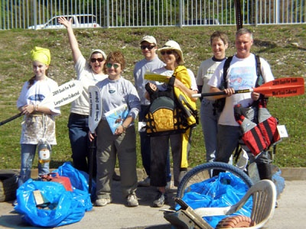
Celebrate
Boat Trips
  Two-day Eco-Heritage Tour
  Two-hour Cruises
  Custom Tours
Community Events
  St. Johns River & Tributary Clean-ups
  River-Friendly Bike Tours
Good Times for a Good Cause
  Annual Oyster Roast
  Rising Tides

Slide 8
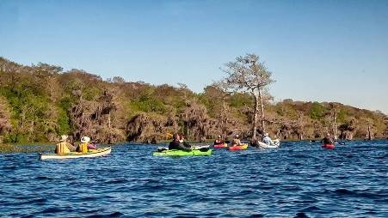
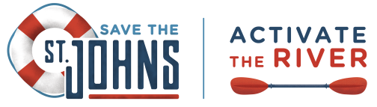
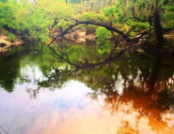
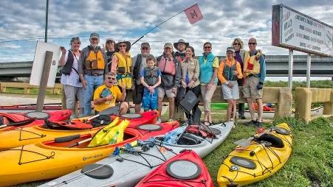
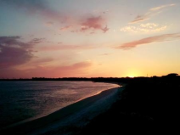

Slide 9
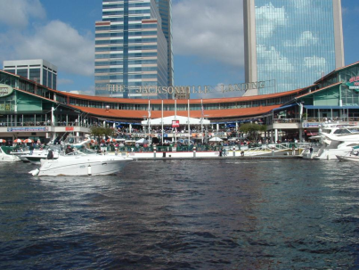
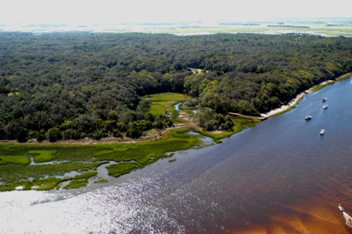
“When we keep our river clean and do the right things, the economic ramifications are tremendous.
We attract more great companies to our city, create high-wage jobs and improve our quality of life.”
Jerry Mallot
JAX Chamber

Slide 10
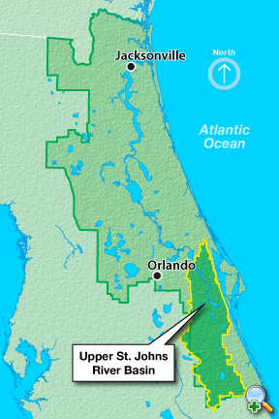

Slide 11
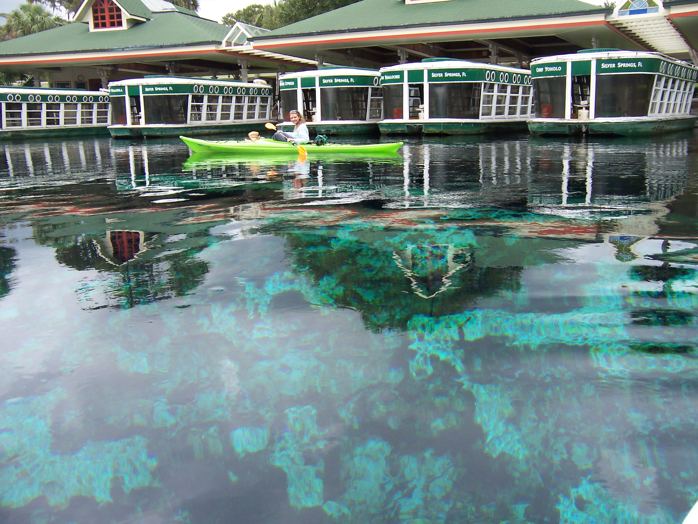
Silver Springs
Notes:
According to Dr. Bob Knight, Director of the Florida Springs Institute, and the Silver Springs 50-year Retrospective Study:
Flows have declined by 32% during the past decade and 50% since 1965
NO3-N has increased by 176% (2,600% over the entire period of record of more than 100 years)
Water clarity has decreased
Nighttime dissolved oxygen has declined by about 19%
Submerged aquatic plant biomass has declined by 21%
Total algal biomass has increased by 371%
Ecosystem productivity has declined by 27%
Insect productivity has declined by 72%
Fish biomass has declined by 92%

Slide 12
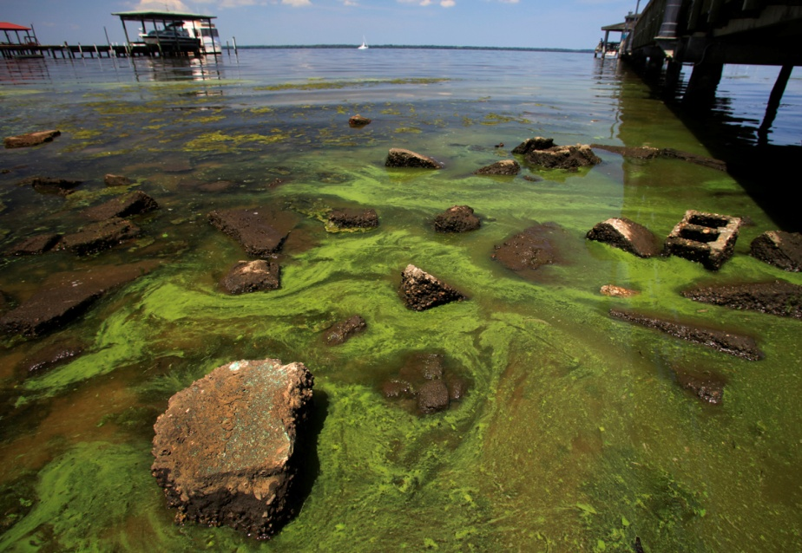
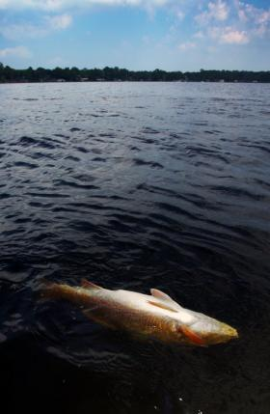
Notes:
The photo of the dead redfish was taken during a massive fish kill in the summer of 2010.
The photo of the algal bloom was taken in Green Cove Springs in 2010 at the City Pier. Photo credit: Walter Coker
The fish kill is thought to be related to toxins that are released from certain types of algae.

Slide 13
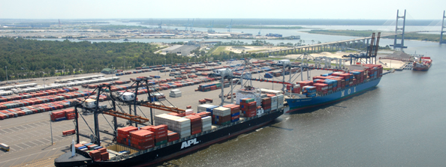
St. Johns River Deep Dredge

Slide 14
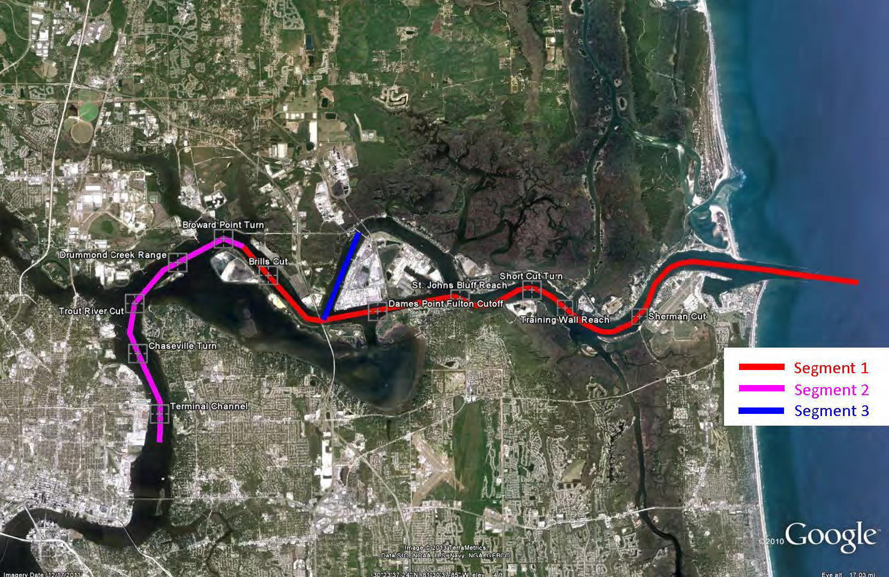

Slide 15
History of Unintended Consequences

Slide 16
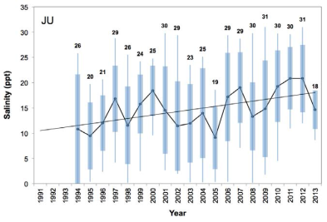
Salinity Mean Trending Up
Notes:
These graphs show the mean trending up.
Maxima also shown because biological organisms are more affected by the extremes, rate of change, and duration.
SAV in Duval Co. is already under a degree of salinity stress

Slide 17
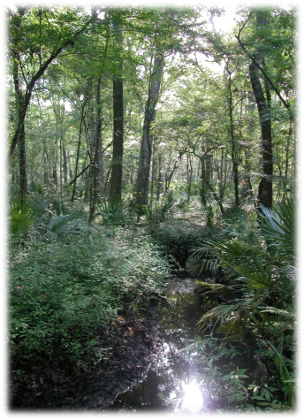
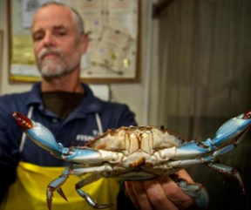
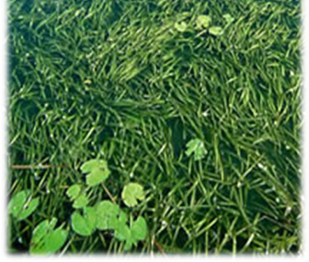
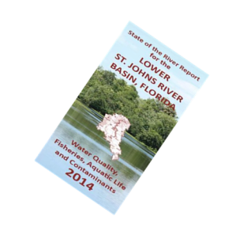
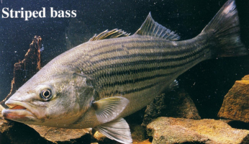
Areas of Greatest Impact
Hardwood swamps
Freshwater and transitional vegetation
SAVs
Tributaries

Slide 18
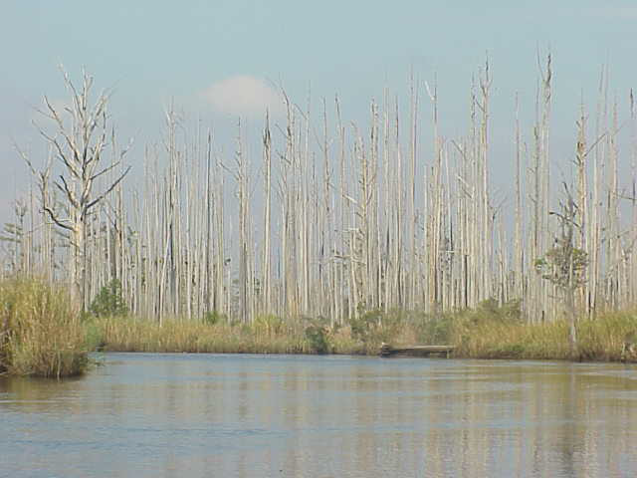

Slide 19

Proposed mitigation is woefully inadequate
Preserving existing healthy SAV and tidal freshwater wetlands does not sufficiently compensate the public for the ecosystem services that will be lost due to deepening the federal navigation channel.

Slide 20
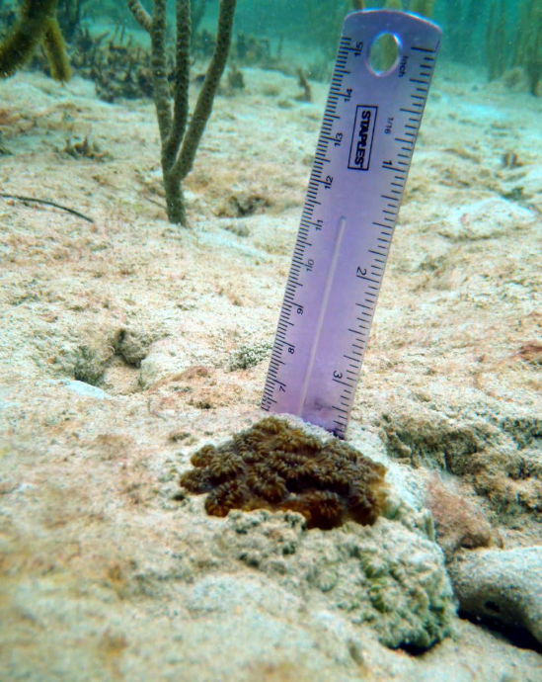


Worst Case Scenario
60% of Colony is Dead
In Violation of Permit

Slide 21
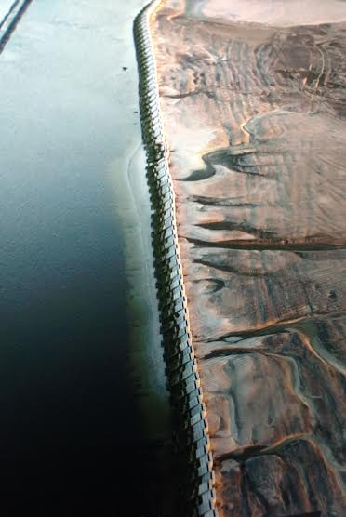

Mile Point
Retaining Wall
Failure
Repair Plan TBA

Slide 22

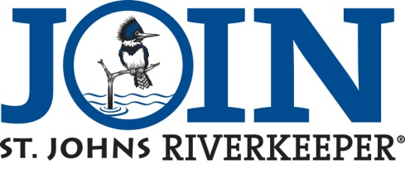
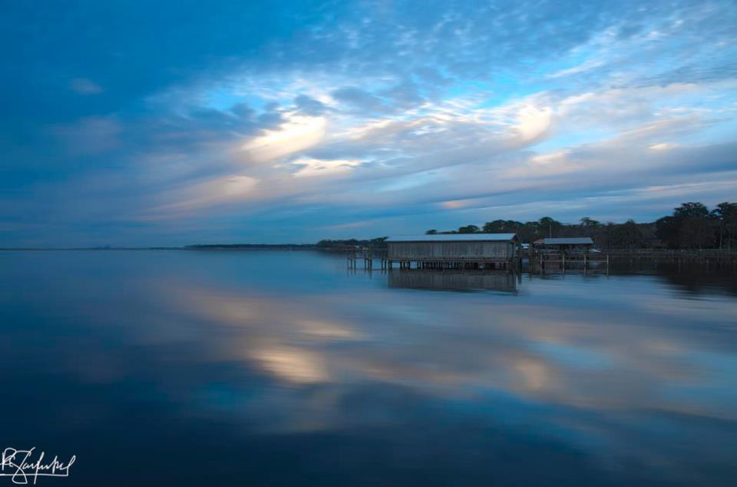
HELP US PROTECT OUR RIVER.
StJohnsRiverkeeper.org
Notes:
Support initiatives to help protect and restore the river, like the stormwater utility.
Use your voice and your vote to communicate with elected officials and to elect pro-river candidates.
Get to know the river by exploring the St. Johns and learning about the problems that impact its health.
Be River Friendly – conserve water, create River Friendly Yards, use fertilizers and pesticides sparingly.
Become a St. Johns Riverkeeper member. We are privately-funded, independent voice for the St. Johns River. We rely on our members to sustain our advocacy work.
The bottom line is that we all need to be involved in the decisions that determine the future of the river, and we all need to do our part to reduce our impact upon its health. Together, we can restore the health of the St. Johns.

